Slide 1
Cook County COVID-19 Vaccination Plan
Rachel Rubin, MD, MPH Kiran Joshi, MD, MPH
Senior Medical Officer and Co-Lead Senior Medical Officer and Co-Lead
Cook County Department of Public Health Cook County Department of Public Health

Slide 2
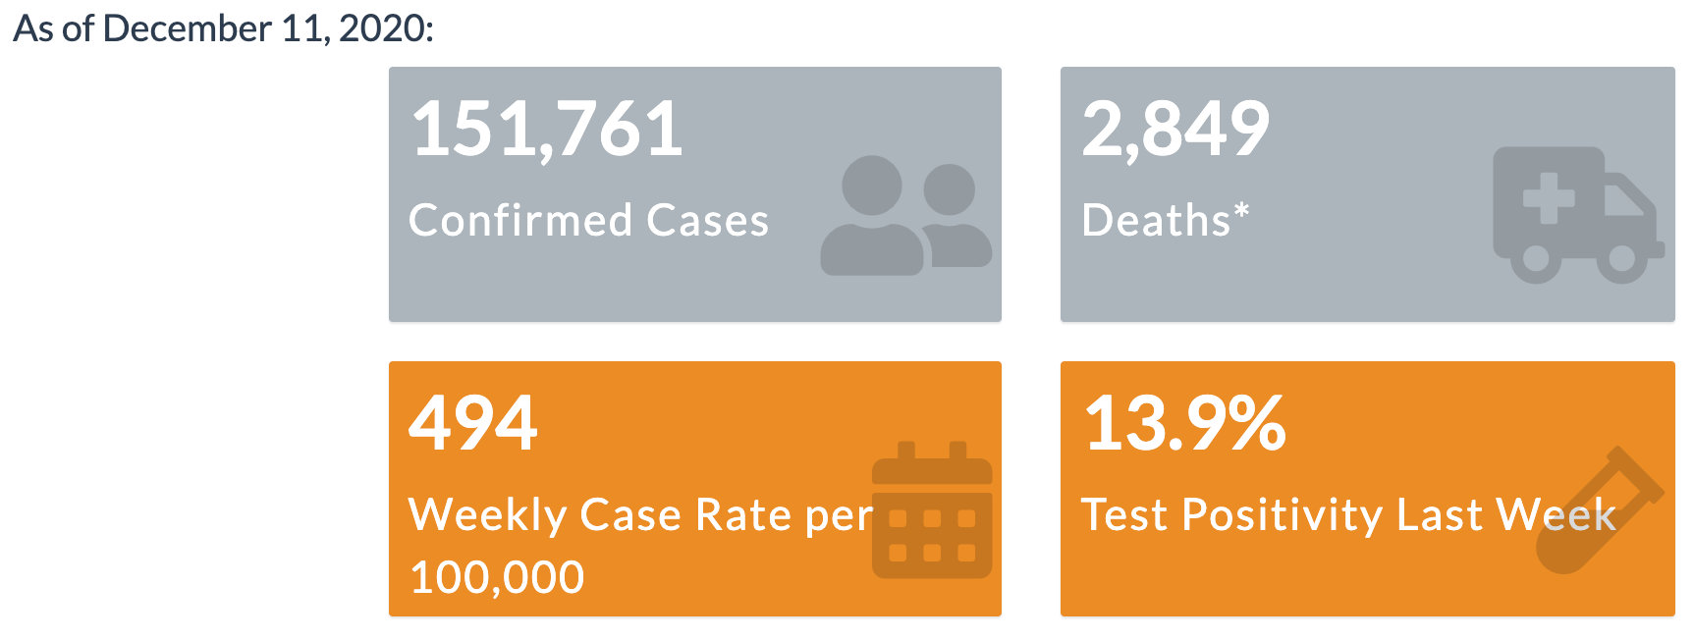
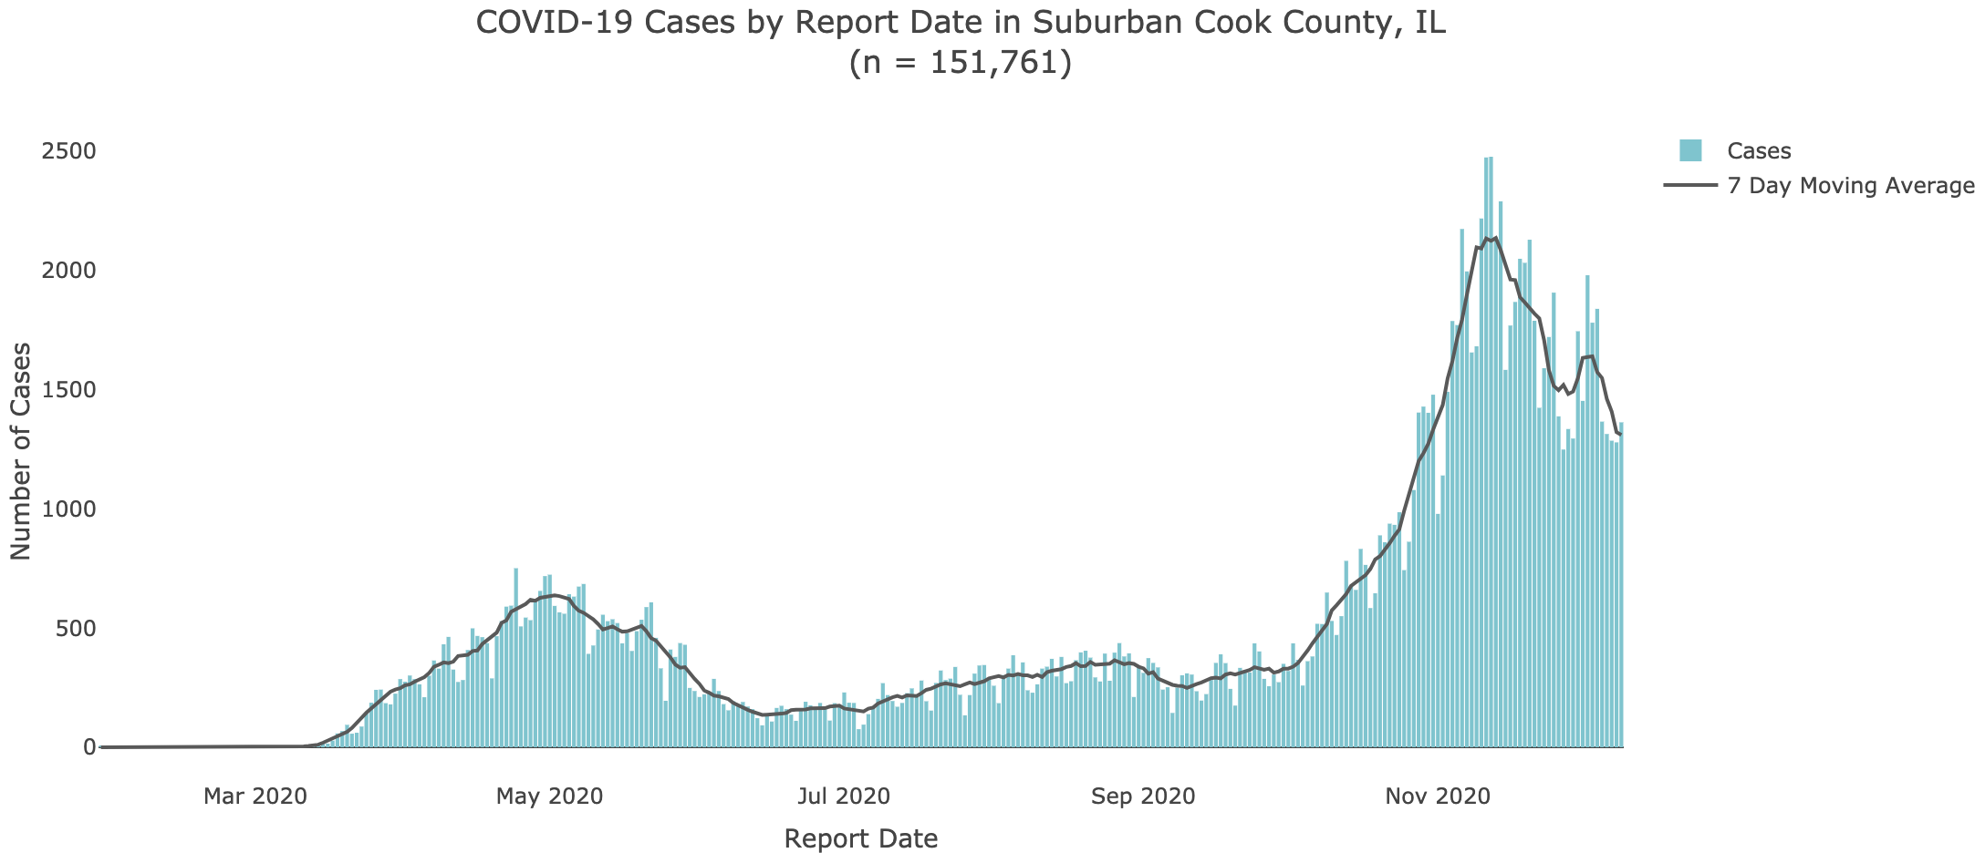
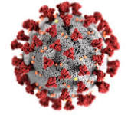
Current Situation

Slide 3
CCDPH Response
Investigated 12,799 COVID-19 cases
Investigated 260+ cases or close contacts related to schools
Provided more than 200 congregate settings with ongoing technical assistance and support
Responded to over 300 food establishment complaints and 100 in other workplaces
Cited 84 establishments for violation of Tier 3 mitigation measures
Responded to over 10,000 inquiries from the public

Slide 4
Pfizer-BioNTech COVID-19 vaccine
First ever mRNA vaccine, allowed for rapid development
Trial participants included 9.3% African American, 4.3% Asian, 28% Latinx, all adults 16 years or older
Side effects included: injection site pain, fever, fatigue, headache, muscle aches
Efficacy 95% overall after two doses
Similar across age, gender, race, and high risk conditions
Full protection two weeks after second dose
https://www.nejm.org/doi/full/10.1056/NEJMoa2034577 on 12/22/2020
https://www.cdc.gov/vaccines/acip/meetings/downloads/slides-2020-12/slides-12-11/COVID-02-Gruber.pdf on 12/13/2020
https://www.fda.gov/media/144246/download on 12/13/2020

Slide 5
Pfizer-BioNTech COVID-19 vaccine
Persons who have had a severe allergic reaction to any vaccine or injectable therapy (intramuscular, intravenous, or subcutaneous) should not receive the Pfizer vaccine at this time
Appropriate medical treatment used to manage immediate allergic reactions must be immediately available
Vaccine providers should observe patients after vaccination to monitor for the occurrence of immediate adverse reactions

Slide 6
CDC – Advisory Committee on Immunization Practices (ACIP) Phased Approach for Vaccine Allocation
Phase 1: Provide limited supply of COVID-19 vaccine and/or vaccinations to:
1a – Health care workers, beginning with hospital based, highest risk of exposure
1a – Long-term care facility (LTCF) staff and residents
1a – Unaffiliated healthcare workers including EMS personnel
1b – (ACIP recommendations pending) Essential workers, including first responders, corrections officers, education sector, food and agriculture, utilities, transportation
1c – (ACIP recommendations pending) High risk adults
Notes:
Objective 1 (Phase 1 Vaccination Operations): Provide limited supply of COVID-19 vaccine and/or vaccinations to identified priority critical populations in suburban Cook Co., according to Advisory Committee on Immunization Practices (ACIP).
Objective 2 (Phase 2 Vaccination Operations): Expand the vaccination strategy to provide COVID-19 vaccine / vaccinations in a manner that allows for equal access to the vaccine to:
Phase 1 critical population members who were not vaccinated in Phase 1
Remaining critical population groups
General population

Slide 7
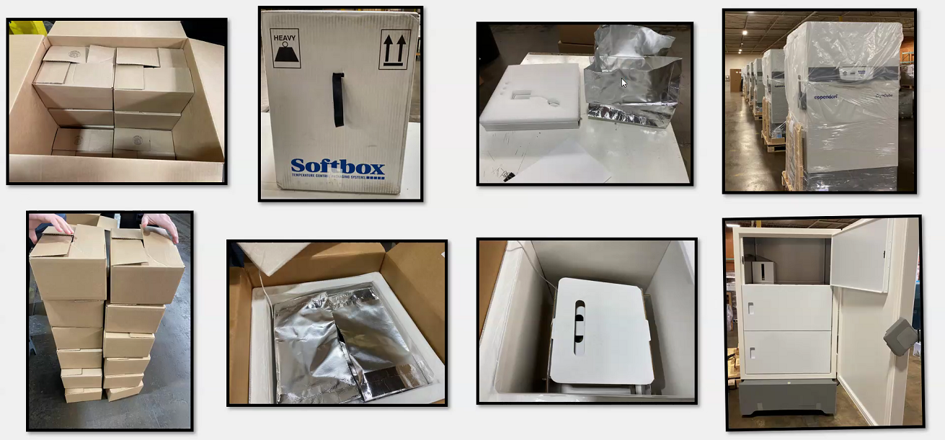
Phase 1a – Pfizer Wave 1, Hospitals
Approximately 20,000 doses being shipped to suburban Cook County this week
Allocated to 15 hospitals based on essential personnel and COVID impact
Hospitals to prioritize based on risk to workers
Will continue to receive additional vaccine weekly
Anticipate vaccine to long term care facilities next

Slide 8
CDC – Advisory Committee on Immunization Practices (ACIP) Phased Approach for Vaccine Allocation
Phase 2: (ACIP recommendations pending) Expand the vaccination strategy to provide COVID-19 vaccine and/or vaccinations in a manner that allows for equitable access to:
Phase 1 critical population members who were not vaccinated in Phase 1
Other congregate settings (homeless, group homes, facilities housing disabled)
Phase 3: (ACIP recommendations pending) Continue to ensure equitable access to vaccination services in suburban Cook County

Slide 9
Vaccine Strategy
Partnerships are key to achieving the goal of 70% vaccine uptake required for herd immunity
Overarching strategy is for healthcare providers in the community to immunize
CCDPH will take the lead in coordination, immunizing critical populations, and identifying and bridging gaps in coverage
CCDPH will continue to monitor testing, contact tracing, vaccination data, and guidance to refine and update allocation strategies
Notes:
Phase 1-A
Data from all hospitals and LTCs throughout SCC to identify the number of essential personnel
Strategically respond to areas that have the highest burden of cases
CCDPH will continue to monitor testing, contact tracing, vaccination data, and guidance to refine and update allocation strategies
CCDPH is actively reaching out to the large pharmacies and employers who are partners to reach larger groups of individuals and family members. Partnerships developed during the initial wave of the pandemic and testing initiatives will assist in reaching diverse populations and communities.

Slide 10
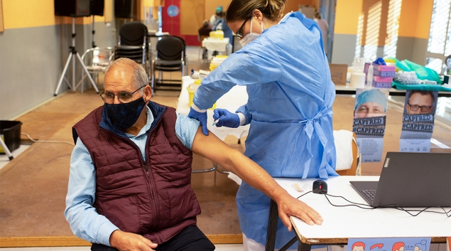
Partnerships
Cook County Emergency Operations Center
Vaccine receipt, storage, distribution
Ongoing logistical and operational support
CCH and CCDPH collaboration on vaccination sites
Epidemiological data will inform site selection and staffing estimates
Strategically respond to areas that have the highest burden of cases
Pharmacy Partnerships
Federal - CVS/Walgreens for Long Term Care Facilities
Federal - chain and independent community pharmacies
CCDPH is working closely with:
Regional HealthCare Coalitions (RHCC)
Federally Qualified Health Centers (FQHC)
Long-Term Care Facilities (LTCFs)
Pharmacies
Many others
Notes:
support provider recruitment efforts, CCDPH has shared specific guidance on the types of organizations and providers to be prioritized for enrollment into I-CARE during Phase 1 and subsequent phases.

Slide 11
Planned Locations for Vaccine Administration
Hospitals
LTCFs (via Federal Pharmacy Program)
CCDPH / Cook County Health sites
Your healthcare provider or pharmacy
Mobile and drive-through sites

Slide 12
Key Issues
Significant logistical/operational complexity due to cold chain requirements, scale
Existing inequities in healthcare access
Many, many myths and much disinformation, vaccine hesitancy, distrust

Slide 13
Challenges – Health Inequities
COVID-19 Case Rates in Suburban Cook County
Social Vulnerability Index
Highest case rates are in areas with highest vulnerability.

Slide 14
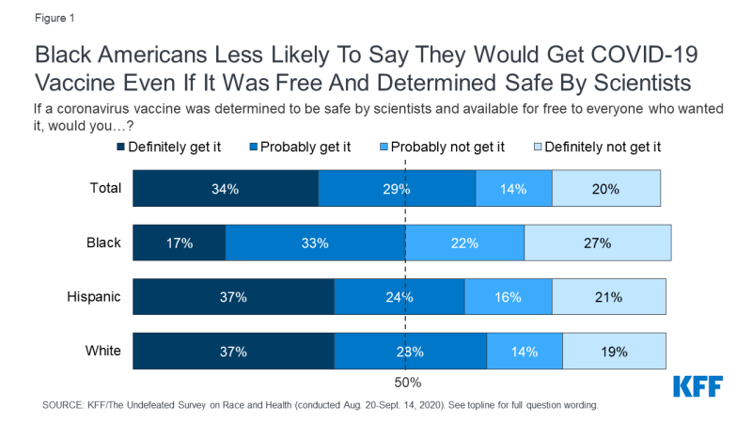
Challenges – Vaccine Hesitancy
Source: Kaiser Family Foundation

Slide 15
Challenges – Myths and Disinformation
Myth: The process was rushed and compromised safety.
Fact: The vaccine was studied in thousands of people over a two month period, has undergone rigorous review by the FDA, CDC, and data were published in the New England Journal of Medicine.
Myth: People who get vaccinated don’t have to wear masks anymore.
Fact: Evidence shows that vaccination will prevent people from getting sick, but they may still acquire and transmit the virus to others.
Myth: The vaccine has microchips that allow the government to track people.
Fact: Nope.

Slide 16
In Summary
The Pfizer COVID-19 vaccine is safe and effective, every eligible person should get one
COVID-19 vaccines will roll out in phases, with healthcare workers, seniors, essential workers first
Many, many partners will be involved
If you are a healthcare provider, please sign up to become a vaccine provider!
For more information, go to cookcountypublichealth.org

