Slide 1
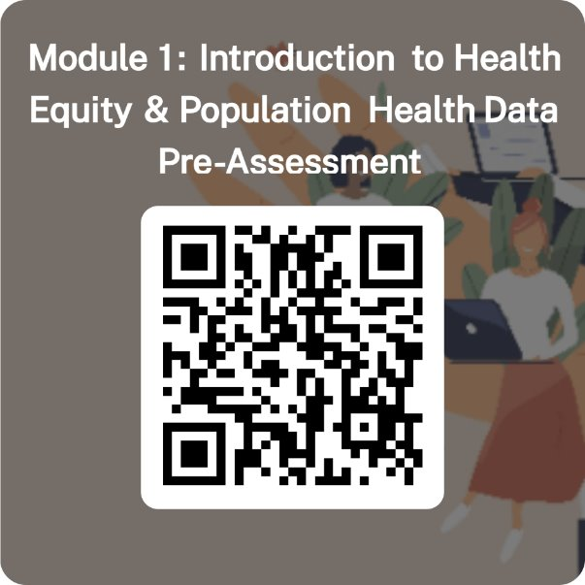
Welcome! As we wait for participants to join, please complete this Module 1 pre-assessment.
Link to Pre-Assessment in Chat

Slide 2



Module 1: Introduction to Health Equity and Population Health
Dr. Alfreda Holloway
Madison Gardner
CCDPH Data Ambassadors Program
September 2025
Notes:
SAY:
Greeting & Introduction "Hello everyone! I’m delighted to join you virtually today and look forward to working alongside our community members, community-based organizations, and changemakers.
My name is Alfreda Holloway, and I serve as the Director of Epidemiology at the Cook County Department of Public Health. I’m excited to be presenting along with our Applied Epidemiology Fellow, Madison Gardner."
Context & Purpose "Together, we’ll be leading you through Module 1: Introduction to Health Equity and Population Health, the first session of the CCDPH Data Ambassadors Program. This program is designed to strengthen the capacity of community leaders and organizations to use data in advancing health equity."
Health Atlas Highlight "We’ve also developed the Cook County Health Atlas in partnership with Metopio and the University of Illinois-Chicago. You can find it at cookcountyhealthatlas.org. The Atlas offers a wealth of information and powerful tools to visualize data, helping us better understand health challenges and opportunities across communities."
Transition "With that, let’s dive into today’s module and begin exploring how health equity and population health come together to shape community well-being."

Slide 3
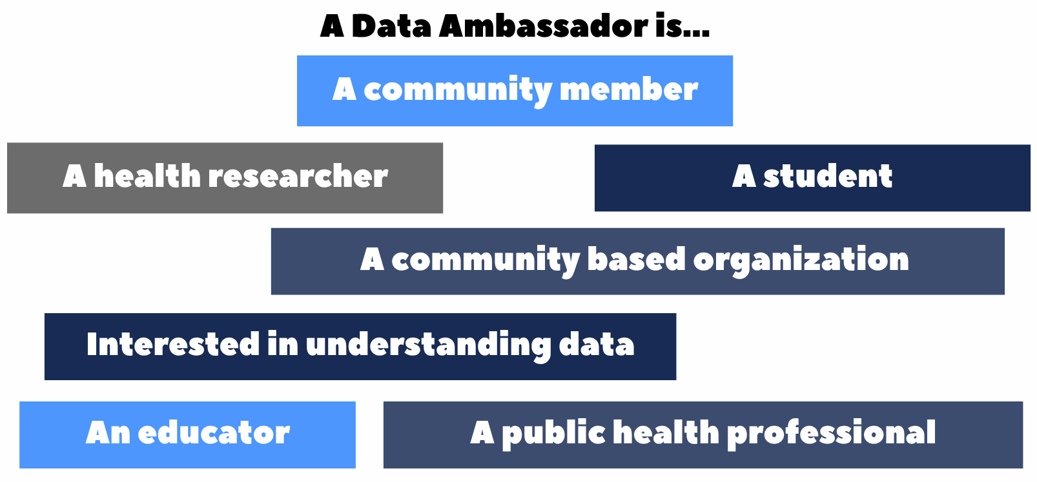
What is a Data Ambassador?
The Data Ambassadors Program provides the opportunity for community partners to gain foundational data literacy skills and reduce barriers to accessing population health data on the Cook County Health Atlas.
Notes:
SAY:
Introduction to the Concept "So, you might be wondering — what exactly is a Data Ambassador?
A Data Ambassador is anyone who is passionate about using data to better understand their community and to help make change. This could be a community member, a student, a researcher, a teacher, a public health professional, or even a community-based organization."
Inclusivity & Accessibility "The point here is that you don’t need to be a statistician or a data scientist to be a Data Ambassador. If you’re interested in understanding data and using it to tell the story of your community, you’re in the right place."
Program Purpose "The Data Ambassadors Program was created to provide community partners with foundational data literacy skills. Our goal is to reduce barriers to accessing and using population health data through the Cook County Health Atlas, so that more voices are represented in decision-making and advocacy.“
I also want to pause and thank the teams that made this possible — our colleagues in Epidemiology, Community Engagement & Health Education, Behavioral Health, and Communications at CCDPH. We’re also grateful for our partners at UIC’s Population Health Analytics, Metrics, and Evaluation (PHAME) Center, as well as the 15 community-based organizations who co-designed this series with us.
This is one of four Modules in the series. At the end of the full workshop series — after Module 4 — you’ll also get access to:
A recording of all sessions, and
A Toolkit PDF that pulls together the key materials and resources we’ve covered from Module 1 through Module 4.
Transition "Throughout this program, you’ll see how the Atlas can be a tool not just for professionals, but for all of us to better understand and address the health needs of our communities.“
With that, I’ll hand it off to Madison."

Slide 4
Welcome! Please write your name and the organization you represent in the chat. Our team has also prepared a pre-survey, please take a moment to complete it using the link in the chat.
Notes:
SAY:
To kick things off, we’re going to start with a quick icebreaker using Slido.
Please take a moment to go to slido.com on your phone or computer, and enter the code: 1852990 to join.
This is a fun and easy way to get everyone engaged and connected as we begin—so don’t be shy, jump in!"

Slide 5
Learning Objectives
Module 1: Introduction to Health Equity and Population Health​
Define Health Equity & it's relationship to Epidemiology
Understand how data informs decision-making in community health
Define the role of community in achieving health equity
Use examples of population health data to understand health patterns
Notes:
Module 1: Introduction to Health Equity and Population Health (why did we start with this module)
We selected this module to kick off the Data Ambassador Program, as we want to lay a foundation of the connection between the work that many of you CBO's are engaged with, improving health and health equity within your communities. By providing targeted local access to care, health resources and support to Cook County residents, you work directly to improve health outcomes among the population. Today we will discuss the connections that exist between Health Equity and Population Health data, and how that can be used to serve our targeted communities.
Other Recommendation
"As we begin Module 1, I want to share our learning objectives so you know what to expect from today’s session.
First, we’ll define health equity and explore how it connects to the field of epidemiology.
Second, we’ll talk about the role of community in achieving health equity — because equity can’t happen without community voices leading the way.
Third, we’ll look at examples of population health data, and how they help us recognize patterns in health outcomes across communities.
Finally, we’ll discuss how data informs decision-making in community health — from shaping programs to influencing policy.
By the end of this session, our hope is that you’ll feel more confident in using data as a tool to understand health equity and support positive change in your community."

Slide 6
Activity: What is Health Equity?
Link to Word Map Activity on Slido!
Participants can join at slido.com using the code: 1852990
Notes:
We first wanted to lay some common ground and give you an opportunity to participate, can you use one word to define "Health Equity" so that we can all see if we are on the same page in understanding before we get started today. Please use slido to submit your answer.
Other Recommendation
"Before we dive into definitions and examples, we want to start by laying some common ground and hearing directly from you.
In one word, how would you define Health Equity?
Please go to slido.com and enter the code 1852990 to submit your answer. As you respond, we’ll see your words start to build into a word map on the screen.
This activity will give us a quick sense of the language, ideas, and perspectives in the room. It will also help us see whether we’re on the same page about what health equity means before we move forward."

Slide 7

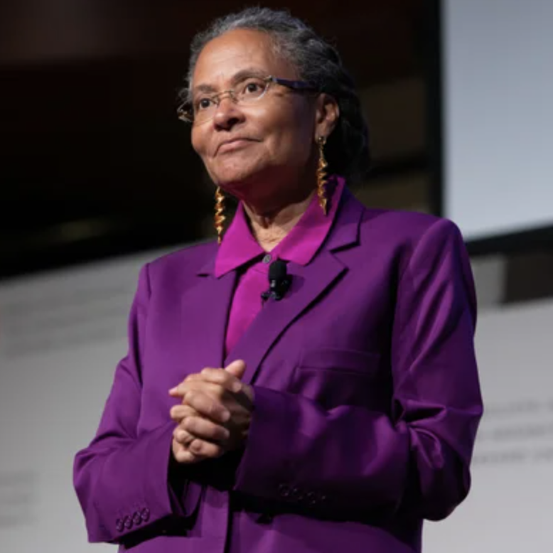
Health Equity is...
The CDC defines Health Equity as "the state in which everyone has a fair and just opportunity to attain their highest level of health."
Health equity, in the words of physician and epidemiologist Camara Jones, MD, MPH, PhD, is “assurance of the conditions for optimal health for all people. Achieving health equity requires valuing all individuals and populations equally, recognizing and rectifying historical injustice, and providing resources according to need.”
Notes:
Read slide and weave in concepts from the Slido activity
"We’re starting here with a shared understanding of what health equity means.
The CDC defines health equity as 'the state in which everyone has a fair and just opportunity to attain their highest level of health.'
Dr. Camara Jones, a leading physician and epidemiologist, expands on this by describing health equity as 'the assurance of the conditions for optimal health for all people.' Achieving equity requires that we value all individuals and populations equally, recognize and address historical injustices, and provide resources according to need.
Now, before we move forward, we’d like to hear from you again. Please head back to slido and, this time, share one or two words that come to mind when you think of health equity. This way, we can see how your perspectives align with or expand on these formal definitions."

Slide 8
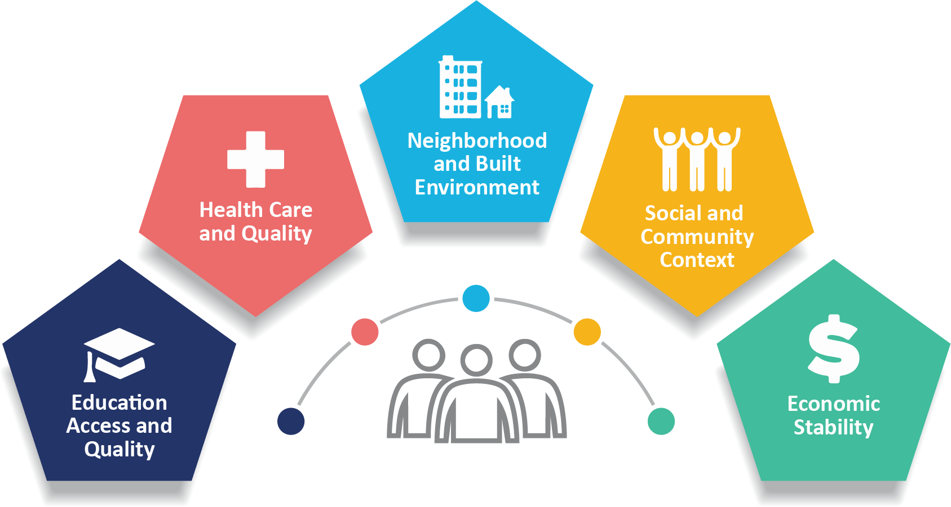
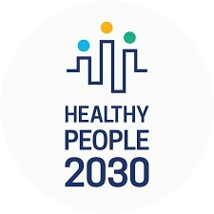
Applying Equity to Public Health
Social determinants of health (SDoH) are the conditions in the environments where people are born, live, learn, work, play, worship, and age that affect a wide range of health, functioning, and quality-of-life outcomes and risks.
One of Healthy People 2030’s 5 overarching goals is to: “Create social, physical, and economic environments that promote attaining the full potential for health and well-being for all.”
Photo source: Healthy People 2030, U.S. Department of Health and Human Services, Office of Disease Prevention and Health Promotion. Retrieved Aug 2025, from https://health.gov/healthypeople/objectives-and-data/social-determinants-health
Notes:
"One way we put these definitions of health equity into practice is through the Social Determinants of Health framework.
Social determinants of health are the conditions in which people are born, live, learn, work, play, worship, and age. These conditions — things like the quality of our neighborhoods, the built environment, access to education, economic stability, and healthcare — all shape health outcomes and quality of life.
By monitoring these conditions, we’re able to see where inequities exist and identify opportunities for intervention.
We also use Healthy People 2030 as a benchmark. This national initiative sets goals for improving health across the country, and one of its key aims is to create social, physical, and economic environments that allow everyone to reach their full potential for health and well-being."
Transition "So when we talk about applying equity to public health, it’s really about understanding these broader conditions and working to change them so that health isn’t determined by your zip code, income, or background."

Slide 9
Applying Equity to Public Health
What is the role of Community-Based Organizations to address health equity?
Trusted messengers in communities
The bridge between data and lived experience
Advocates of community-led change
What is the importance of free public access to public health and community-level data?
Community advocates can use data to inform & tell authentic stories
These data can be referenced to show disparities, need & allocation of resources, and monitor public health actions
Notes:
"When we think about applying equity in public health, one of the most important questions is: What is the role of community-based organizations in this work?
CBOs are often the trusted messengers within communities. They serve as a bridge between data and lived experience, helping ensure that numbers reflect real-life challenges. They’re also the advocates of community-led change, pushing for solutions that are grounded in what people actually need.
The other question is: Why does free public access to health data matter?
When data are open and accessible, community advocates can use them to tell authentic stories about what’s happening in their neighborhoods. These data can highlight disparities, demonstrate needs, guide the allocation of resources, and even monitor the impact of public health actions over time.
That’s really the heart of this program — making sure the right people have the right tools to connect data with lived experience, and then use it to drive meaningful change."
We work towards meeting our goal of improving health equity by collaborating with community-based organizations who serve as trusted messengers between communities and public health professionals, help to bridge the gap between data and lived experience and are advocates of community led change.
"Free public access to public health and community-level data is essential for building transparency, trust, and equity in our systems. When communities have access to data, they can tell authentic stories rooted in lived experience and evidence.
Advocates can use this data to highlight disparities, whether in health outcomes, environmental exposures, or access to care, and make a compelling case for change. It also helps ensure that resources are allocated where they’re needed most, based on real, localized evidence. Public access allows communities to hold systems accountable by tracking the impact of public health interventions over time.
In short, data isn’t just numbers, it’s a tool for empowerment, advocacy, and action."

Slide 10

How does Health Equity relate to Epidemiology?
Epidemiology is the study of health and disease conditions in defined populations
Epidemiologists track disease patterns, causes, and effects
Epidemiology methods support health decision making and policy
Epidemiology intersects with Health Equity when we need to understand differences in the conditions of our environment that can contribute to disparities in health outcomes between different populations.
Photo source: https://www.cdc.gov/obesity/risk-factors/risk-factors.html
Notes:
SAY:
"Epidemiology is the study of health and disease conditions within defined populations.
Epidemiologists track patterns of disease — looking at causes, effects, and who is most impacted. The methods we use also support decision-making and policy, helping leaders understand where to focus resources.
This is where health equity comes in. Epidemiology intersects with health equity when we ask: What differences exist in the conditions of people’s environments, and how do those differences contribute to health disparities?
For example, we might see higher rates of asthma in one community because of poor air quality, or greater rates of diabetes in another community due to limited access to healthy foods. Epidemiology helps us make these connections visible, and health equity ensures we don’t stop at describing the problem, but push toward addressing the root causes."
Transition "So when we talk about data and equity together, we’re really talking about using science to uncover where inequities exist, and then applying that knowledge to create fairer, healthier systems for everyone."
Add script notes
In general, epidemiologists collect and analyze data to uncover trends and risk factors associated with different diseases. We play a critical role in understanding why certain populations may be more vulnerable to health issues.“

Slide 11
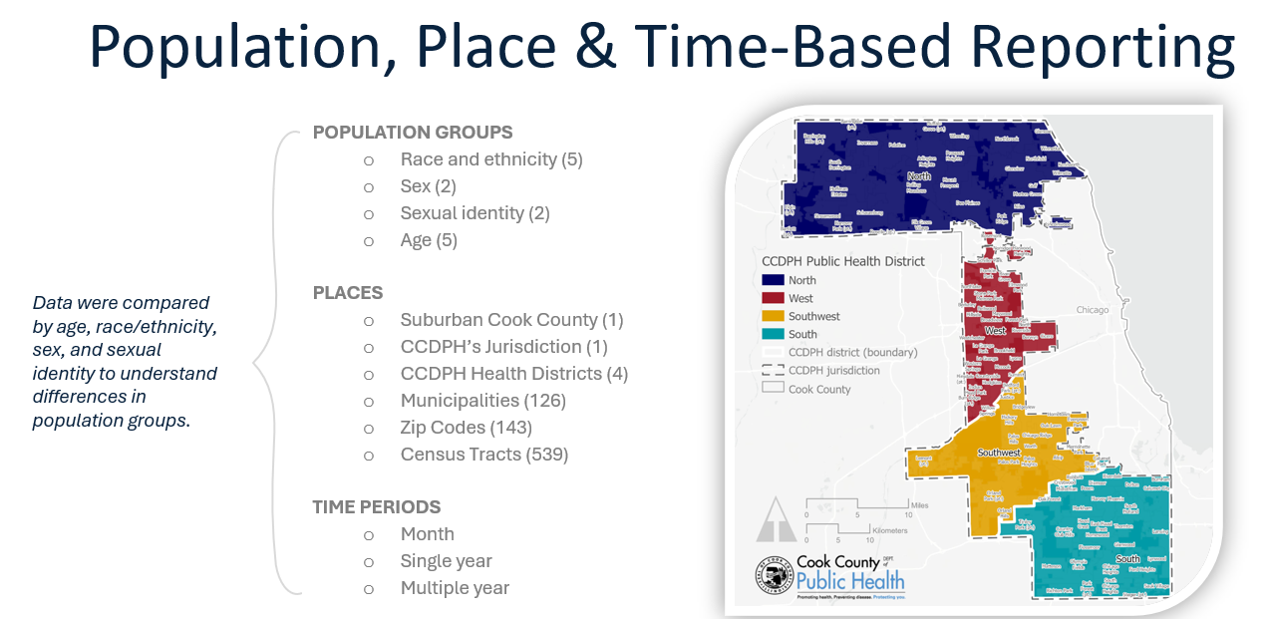
How does Health Equity relate to Epidemiology?
Notes:
SAY:
"When we connect health equity to epidemiology, one of the most important tools we use is population, place, and time-based reporting.
We don’t just look at health outcomes overall — we break them down by population groups, like race and ethnicity, sex, sexual identity, and age. This helps us see who is most affected and whether inequities exist between groups.
We also examine differences by place — looking at suburban Cook County, CCDPH health districts, municipalities, zip codes, and even census tracts. This level of detail helps us identify where resources and interventions are most needed.
And finally, we look at time periods — whether trends are happening month to month, within a single year, or across multiple years. This helps us track changes over time and evaluate the impact of public health actions.
So in practice, epidemiology applies health equity by not just describing outcomes, but by asking: Who is most impacted? Where are the disparities happening? And how are they changing over time?
With that, I’ll pass it to Madison to show you how this looks with some real-world examples."

Slide 12
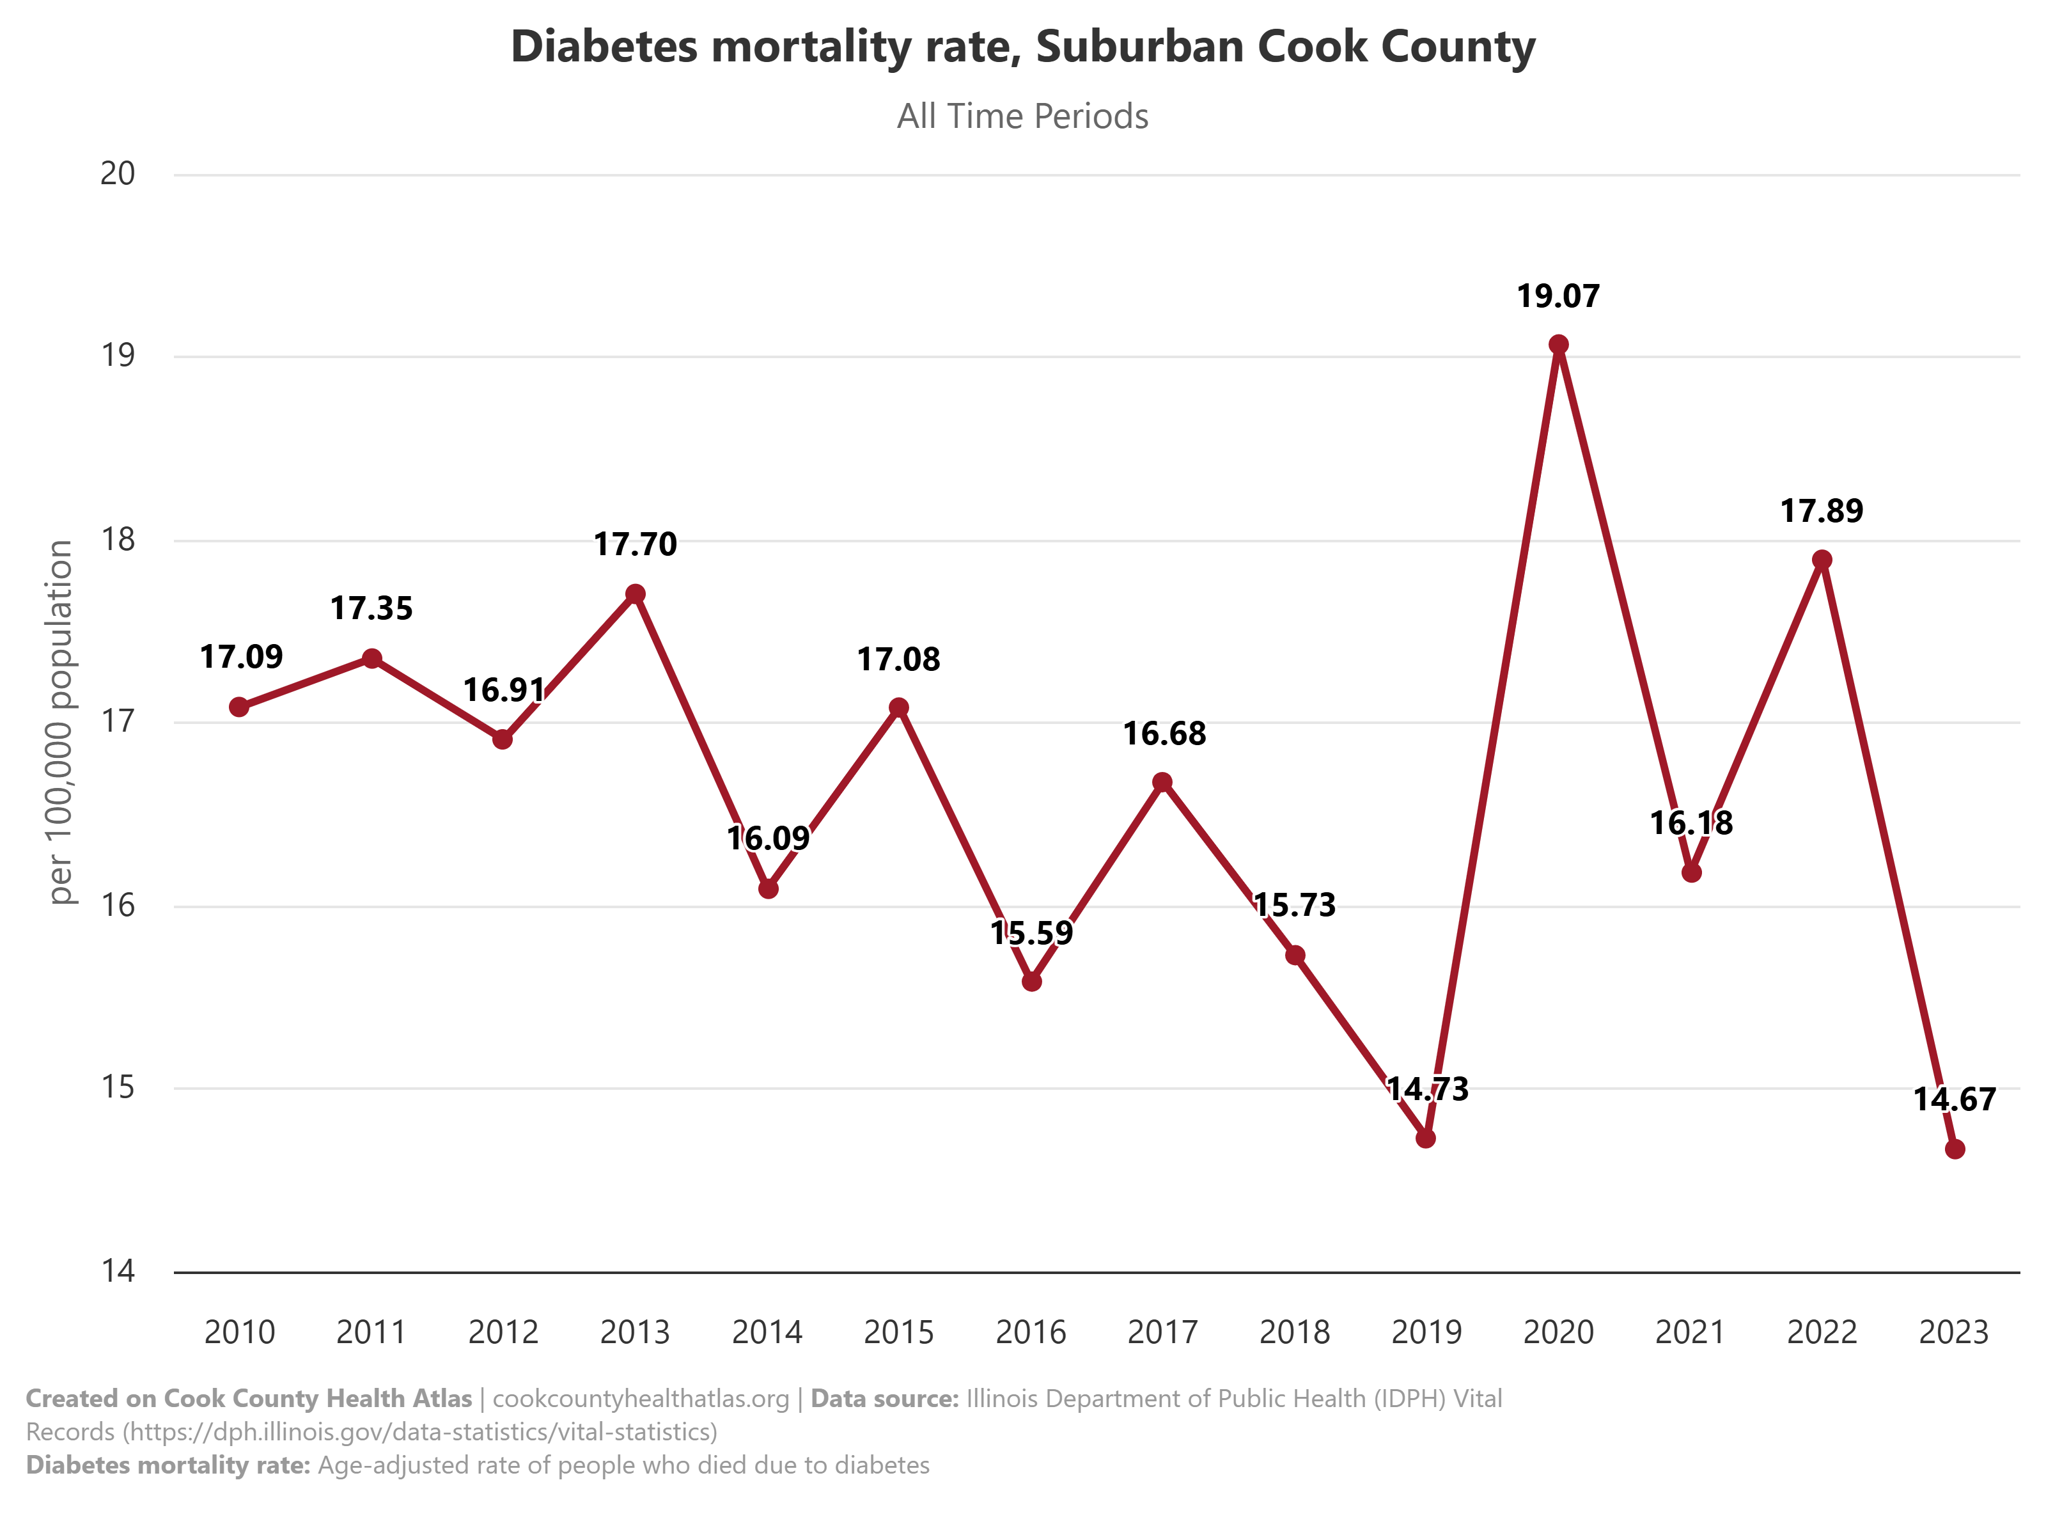
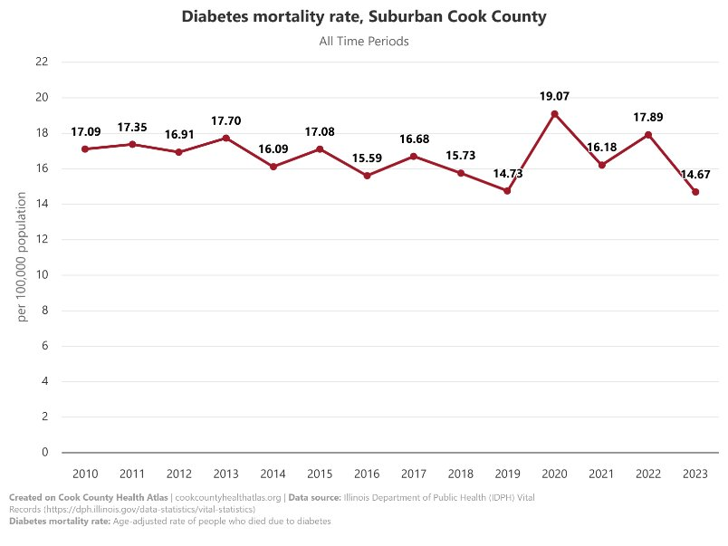
Case Study: Using Health Atlas Data to Identify or Measure an Issue in Community
Example 1: Age-adjusted Diabetes Mortality Rate
This is a line graph of age-adjusted Diabetes Mortality rate in Surburban Cook County from 2010-2023.
What immediate observations do you have from this graph?
For comparison:
The US Diabetes Mortality rate from 2021-2023 was 15.8%. (CDC)
The Illinois Diabetes Mortality Rate from 2021 was 21.8%. (CDC)
Surburban Cook County Diabetes Mortality Rate in 2021 was 16.18%
Based on these comparisons, what would you say about the current rate of Diabetes Mortality in Suburban Cook County?
https://www.cdc.gov/nchs/fastats/diabetes.htm; https://www.cdc.gov/nchs/pressroom/sosmap/diabetes_mortality/diabetes.htm
Notes:
Link to indicator: https://cookcountyhealthatlas.org/indicators/JG8JNTF?tab=chart
Intro to interpretation, we will come back to this later

Slide 13
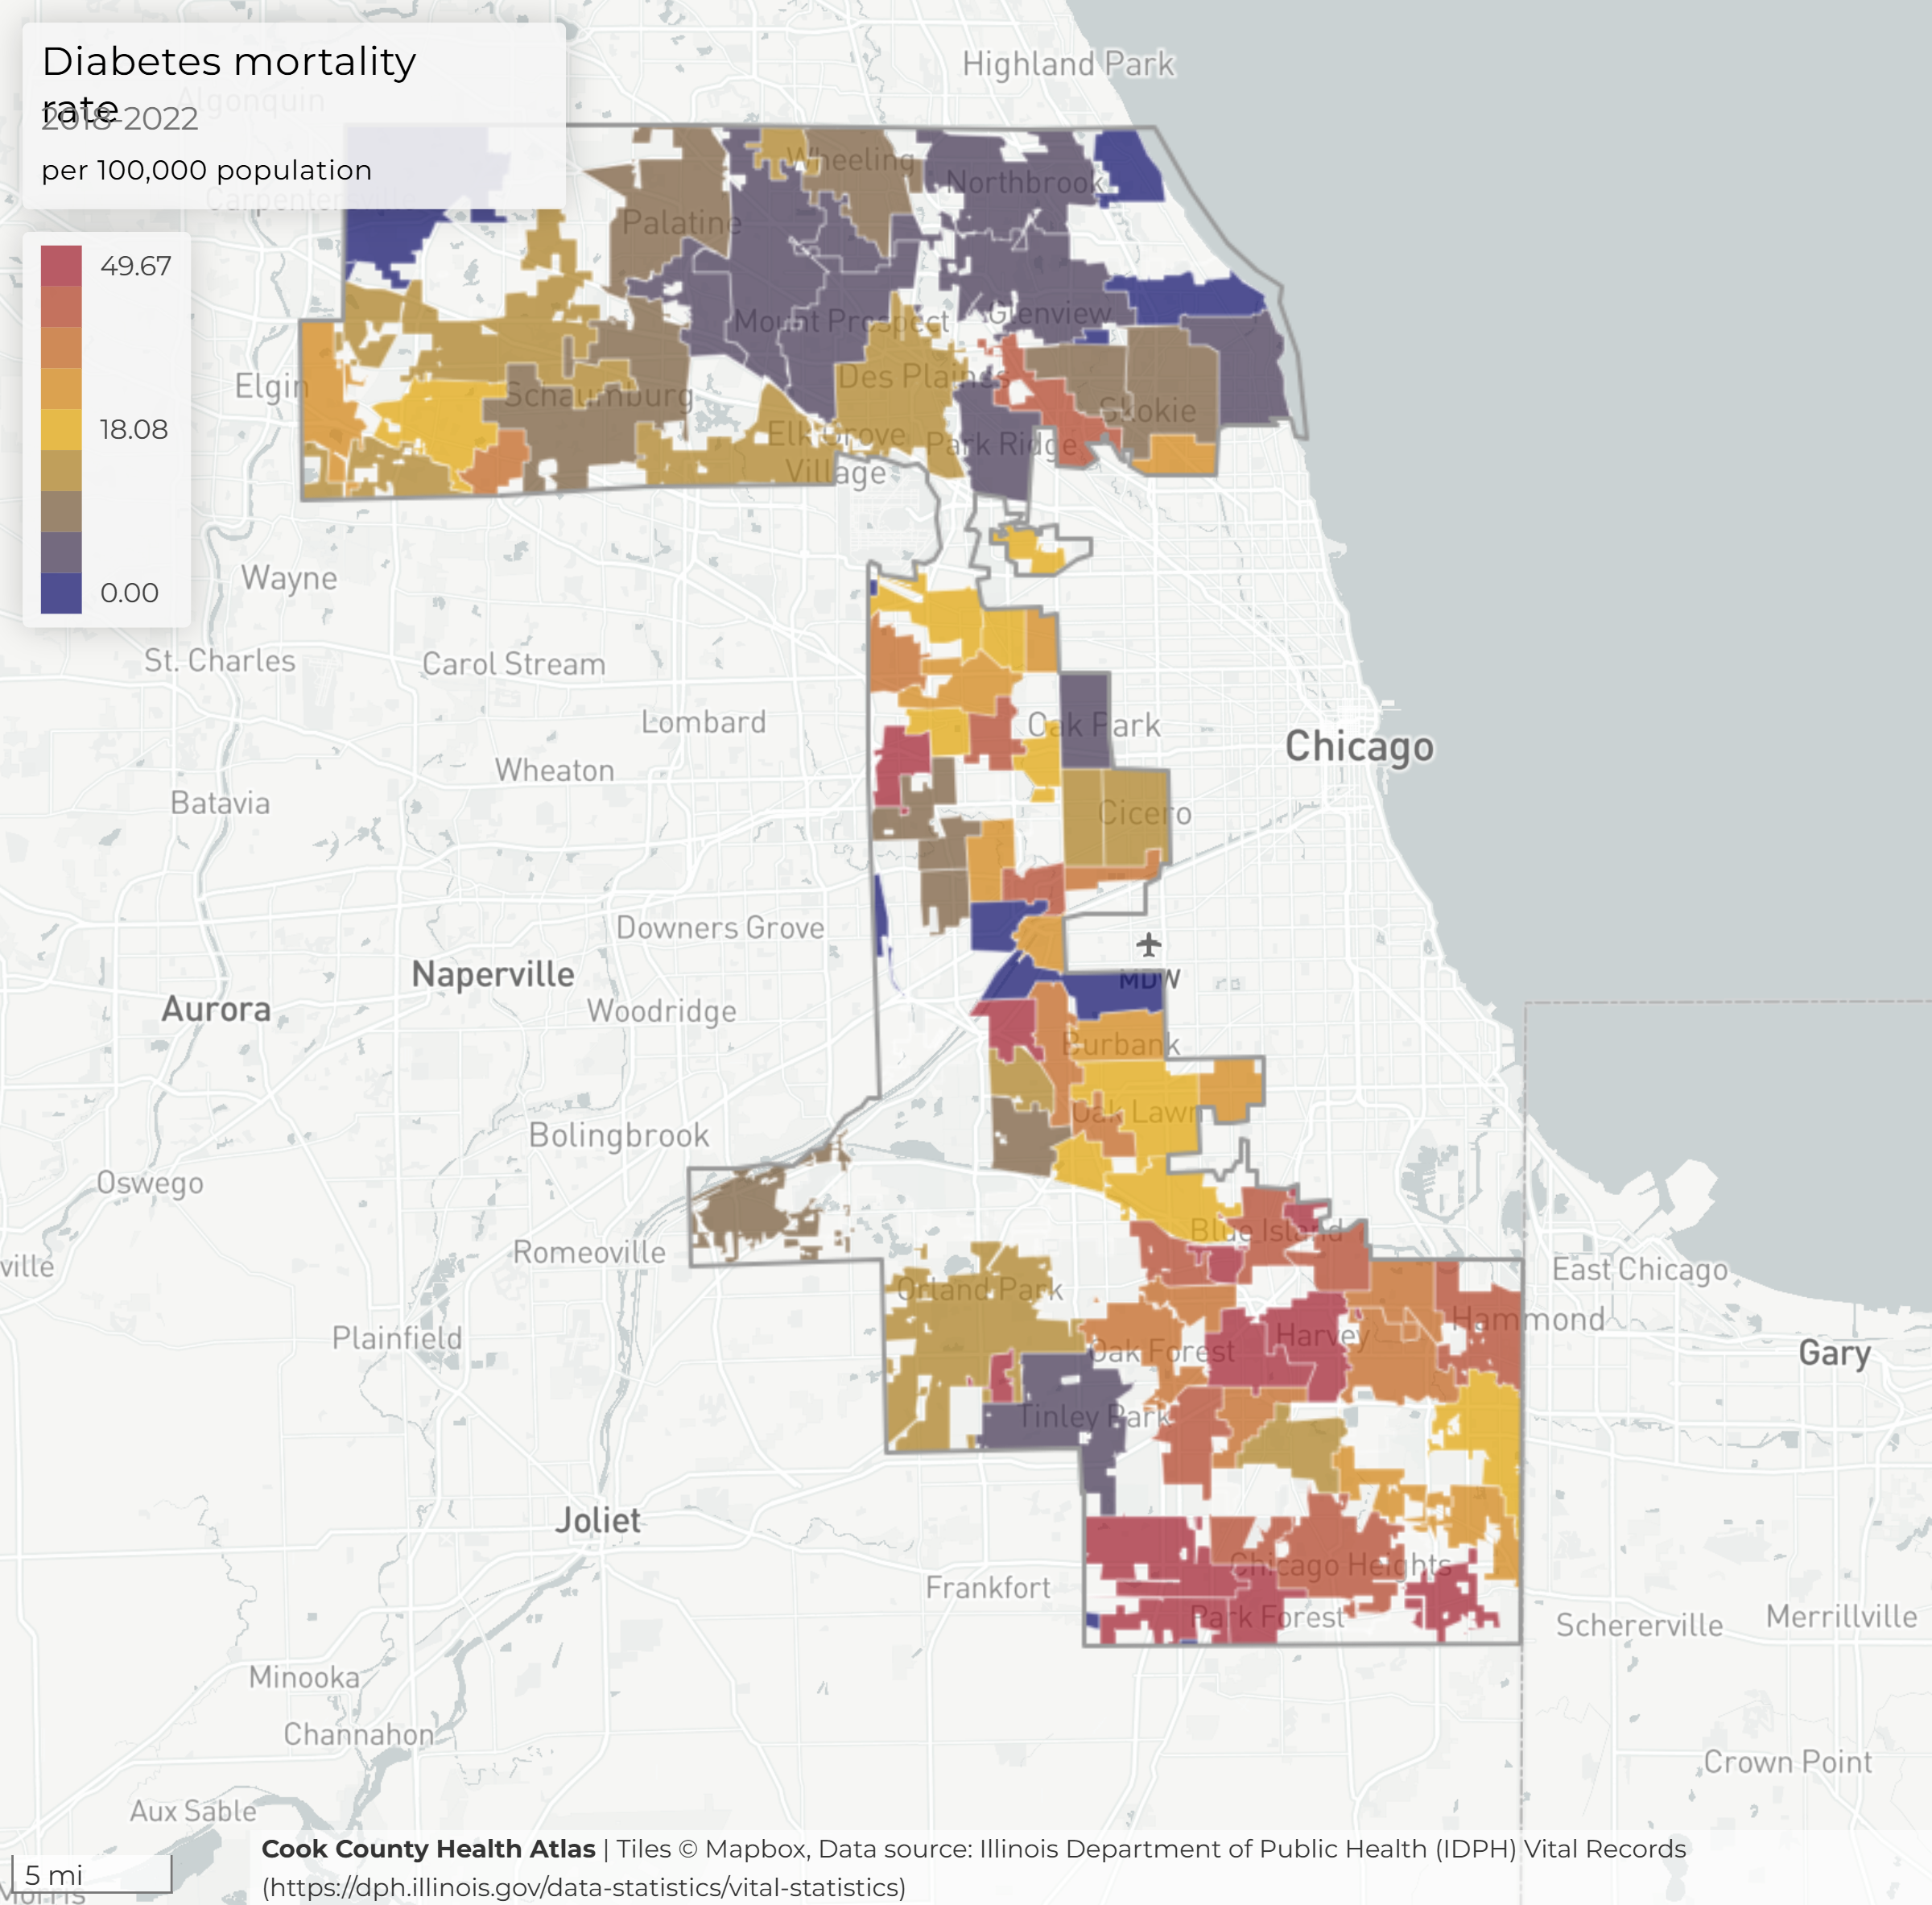
Case Study: Using Health Atlas Data to Identify or Measure an Issue in Community
Example 1: Age-adjusted Diabetes Mortality Rate
Map displays the age-adjusted diabetes mortality rate by suburban Cook County municipality.
Rates range between 0 and 49.67 per 100,000 population between 2018 and 2022.
Cities with highest rates in are largely clustered in ….?
Notes:
Cities with rates in the upper quintile are largely clustered in the south and west areas of suburban Cook County.

Slide 14
What is Population Health Data?

Slide 15
What is Population Health Data?
Health Surveys
Vital Statistics (Birth & Death) Record Data
Hospital Records Data
Electronic Health Records Data
Census Data
Population health refers to the health outcomes of a group of individuals, as well as how those outcomes are distributed within the group.
Population health data is the systematic collection and analysis of health data for a specific group of people.
Data Sources - There are various places data can come from:
Surveys
Case Reporting (Hospital, Coroner)
Data Limitations - There are many limitations to the data we collect
Data "lag" & timing
Patient privacy protection
"Generalizability" of surveys, rates
Notes:
SAY:
"Now let’s talk about population health data.
When we say population health, we’re referring to the health outcomes of a group of individuals, and just as importantly, how those outcomes are distributed within the group.
Population health data is the systematic collection and analysis of information about these outcomes for a defined group of people.
There are many different sources of data we rely on, such as:
Surveys — like health behavior surveys that ask about risk factors or access to care
Vital statistics — birth and death record data
Hospital and coroner case reports — which track diseases, causes of death, and emerging issues
Electronic health records — which provide real-time clinical information
Census data — which helps us understand demographics and population trends
But it’s also important to acknowledge limitations:
Sometimes data has a lag — by the time we receive and analyze it, the situation may have already shifted
We must always balance data use with patient privacy protections
And not all surveys or rates are fully generalizable — meaning they may not represent every community equally
Even with these challenges, population health data gives us a powerful lens to see health patterns, identify disparities, and inform decision-making."
As mentioned, we have data from various sources of data from the Health Atlas, including data from IDPH, Suburban Cook County Health Survey, Behavioral Risk Factor Surveillance System, and more.
But, our data is often limited, we don’t have all knowledge through the data, there are some questions we can't directly answer from data, and some data has a "lag" meaning that we may not have data up to the current year. However, even though there are limitations, there is still a lot of information we can learn from data.
Population health refers to the health outcomes of a group of individuals, as well as how those outcomes are distributed within the group. Epidemiology is the scientific study of the patterns, causes, and effects of health and disease conditions in populations. It forms the foundation for public health interventions and preventive medicine. As a core discipline of public health, epidemiology provides essential methods for conducting research, identifying disease risk factors, and guiding evidence-based clinical practices and treatment strategies.

Slide 16
Discussion: How does Population Health Data inform decision-making?
For example: Epidemiologists can use population health data to generate knowledge that can be directly applied to public health practice, policy-making, and intervention strategies.
How can population health data inform the communities you serve, or the organizations you serve with?
One or two people please come off mute to answer and others can type in the chat with your response.
Notes:
"We’ve just talked about what population health data is and where it comes from — now let’s think about how we actually use it.
For example, as epidemiologists, we use population health data to generate knowledge that can be applied directly to public health practice, policy-making, and intervention strategies.
But I want to hear from you: How can population health data inform the communities you serve, or the organizations you work with?
Maybe it’s helping tell the story of disparities in your neighborhood, maybe it’s guiding funding requests, or maybe it’s shaping how your organization designs programs.
I’d love for one or two people to come off mute and share your thoughts. And for others, please feel free to add your ideas in the chat — we’ll take a moment to pause so we can hear from you.“
ANSWER
With that, I’ll pass it to Madison to show you how this looks with some real-world examples."

Slide 17
Case Study: From Data to Lead Poisoning Prevention Program
2023 Community Canvassing Pilot
Step 1:
Proactive Prevention
Programming Approach
Step 2:
Identify potential areas with elevated Blood Lead Levels using the Cook County Health Atlas
Step 3:
Target prevention to neighbors with lack of testing
Step 4:
Train Community Health Promoters to provide Lead Education & Prevention Resources
Step 5:
Conduct community canvassing and education on Lead Prevention Education & Prevention Resources
Notes:
Notes from Alfreda:
Condense Lead slides into overview
Add in limitations - data can't fulfill prevention without resources, timelines - chronic disease isn't always the most up to date data
Incorporating more discussion on understanding community systems better/ how can this be applied in lower resource settings
Integrate key performance measures/metrics

Slide 18
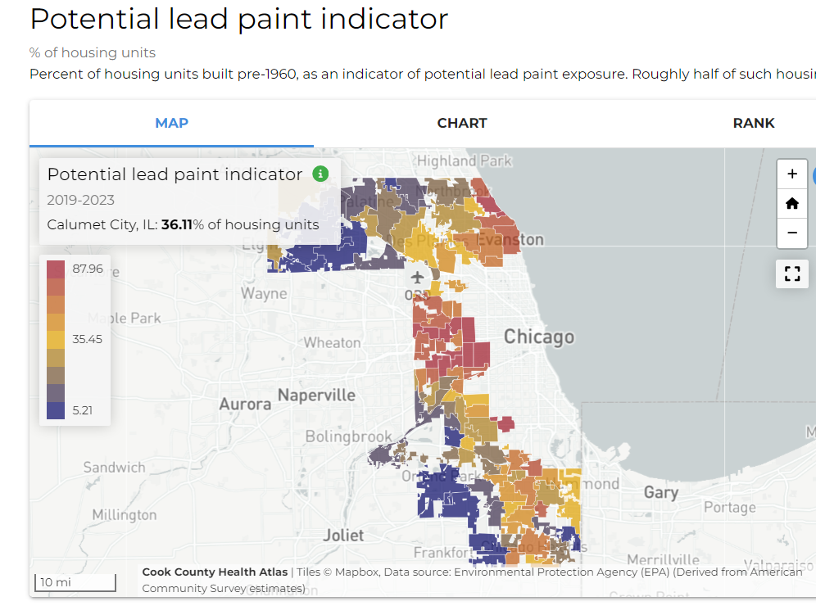
Case Study: From Data to Lead Poisoning Prevention Program
Step 1: Proactive Prevention Programming Approach
CCDPH Lead Program decided to move away from "Reactive" programming that responded to cases of elevated blood lead levels identified among children in SCC and moved into "Proactive" programming to improve prevention education and access in the community.
Step 2: Identify potential areas with elevated Blood Lead Levels using the Cook County Health Atlas
The map highlight shows that in Calumet City, 36.11% of housing usings were built pre-1960, which is used as indicator that there is a potential for lead exposure. ​
Example of data interpretation: "More than a third of Calumet City homes at risk for lead hazards."
Notes:
Notes from Alfreda:
Condense Lead slides into overview
Add in limitations - data can't fulfill prevention without resources, timelines - chronic disease isn't always the most up to date data
Incorporating more discussion on understanding community systems better/ how can this be applied in lower resource settings
Integrate key performance measures/metrics

Slide 19
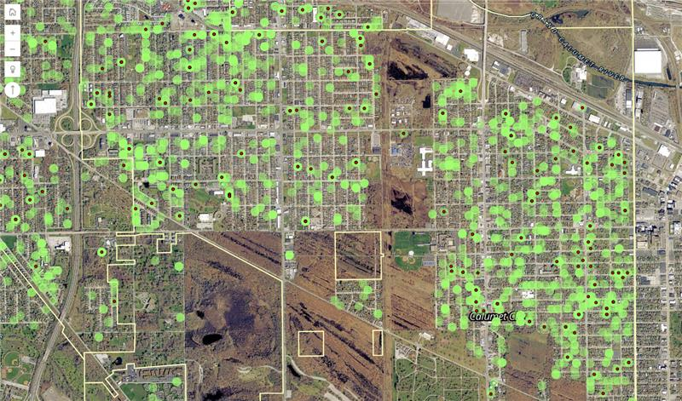
Case Study: From Data to Lead Poisoning Prevention Program
Step 3:
Target prevention to neighbors with lack of testing

Slide 20
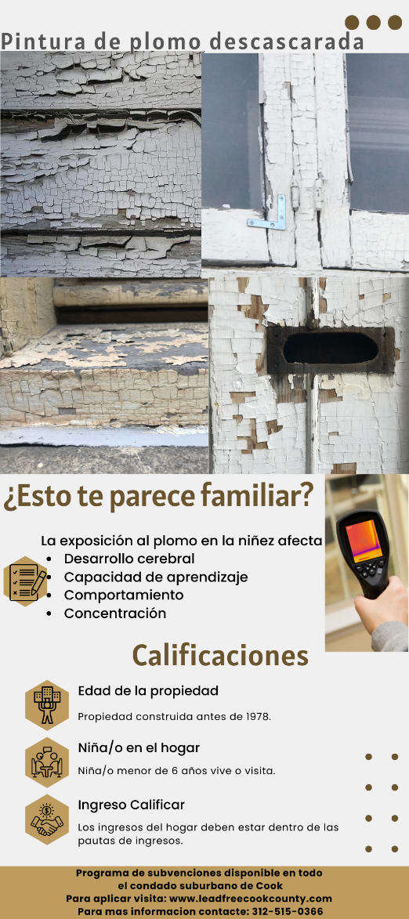
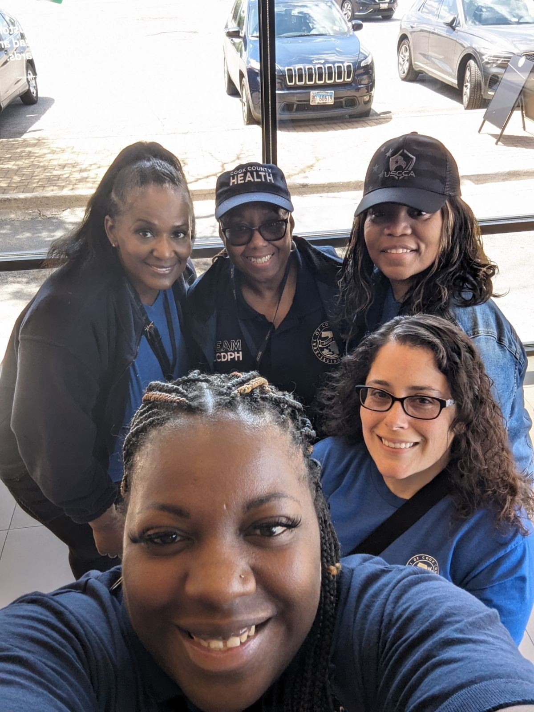
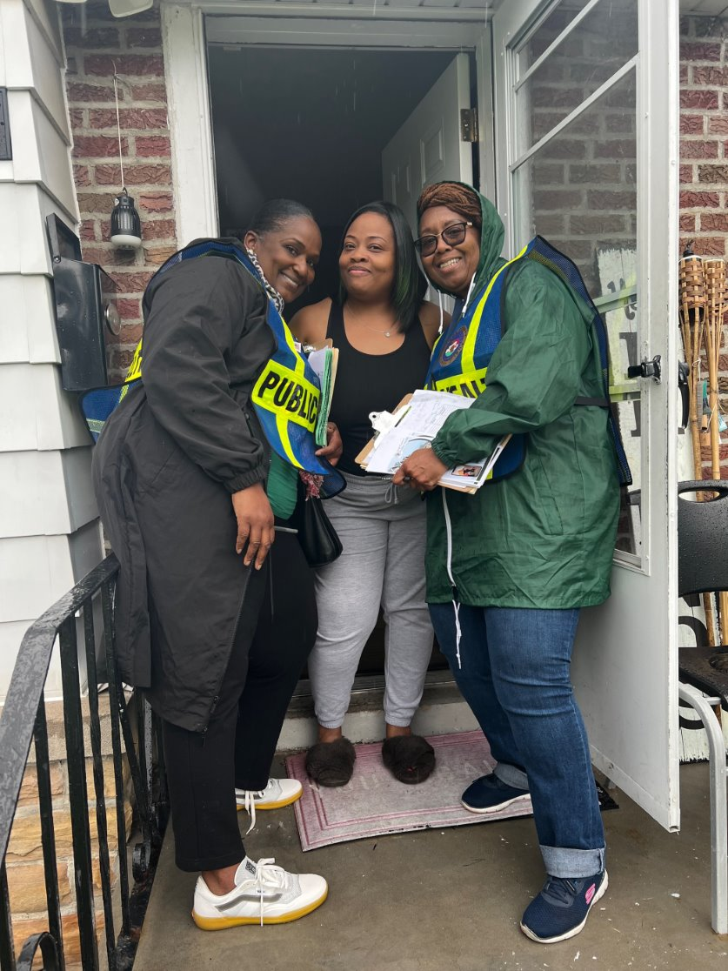
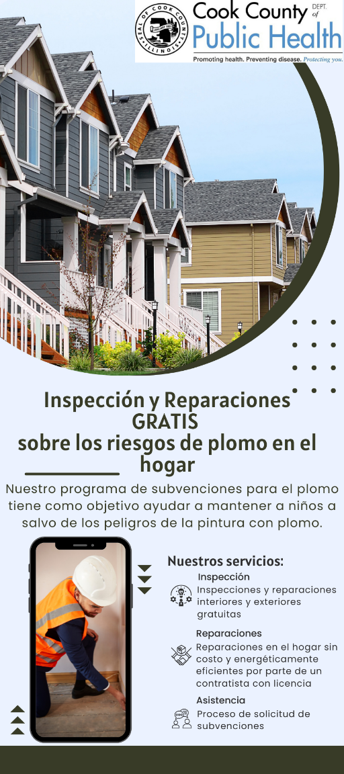
Case Study: From Data to Lead Poisoning Prevention Program
Step 4:
Train Community Health Promoters to provide Lead Education & Prevention Resources
Step 5:
Conduct community canvassing and education on Lead Prevention Education & Prevention Resources
Notes:
CHP Team Training - Safety Protocol Development and Run through
Outreach and Education- Flyers were canvassed in English & Spanish

Slide 21
Case Study: From Data to Lead Poisoning Prevention Program
Lead Door-to-Door Canvassing – Overall Impact
Pilot in Sept 2023; “Canvassing 2.0” in May 2024
Homes Reached: 313
Doors Answered: 107
Materials Left: 206
Community Event: 50 Residents

Slide 22
Case Study: From Data to Lead Poisoning Prevention Program
Discussion Questions
Overall reflections from the case study example....
What did you think about this initiative?
Do you think this type of project implementation would be possible at your organization? (What challenges could come with this?)
Please come off mute to answer or type in the chat with your response.
Notes:
If typing in the chat, please note which question you are answering

Slide 23
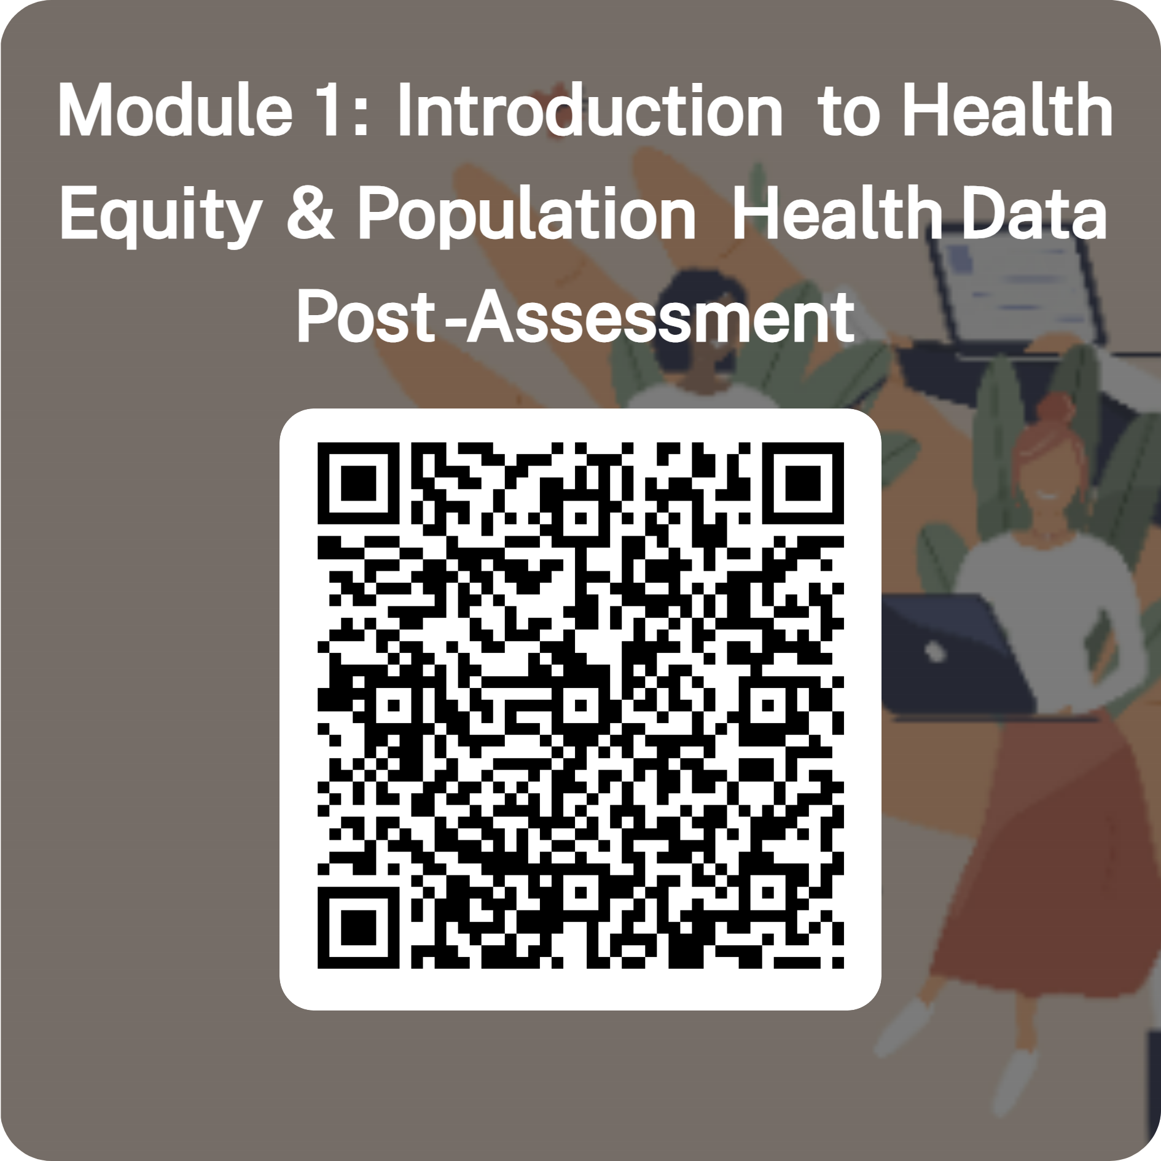
Thank you for participating in Module 1!
Thank you for your participation in Module 1 of the Data Ambassador Program, Introduction to Health Equity and Population Health Data
Please complete the Post-Assessment form
Next session:
In-Person on Tuesday, September 9th, 8:30AM – 12:30PM
Location: UIC School of Public Health, Room 132
We will go over Module 2: Navigating the Health Atlas & Module 3: Data Interpretation & Application
Notes:
"Thank you all so much for your participation in Module 1 of the Data Ambassador Program: Introduction to Health Equity and Population Health Data.
We really appreciate the energy and thoughtful input you brought into today’s session — whether through the Slido activities, the discussion, or simply reflecting on how this connects to your work.
Our next session will be in-person on Tuesday, September 9th, from 8:30AM to 12:30PM at the UIC School of Public Health, Room 132. In that session, we’ll dive into Module 2: Navigating the Health Atlas, and Module 3: Data Interpretation & Application — which is where you’ll start putting what you’ve learned into practice.
At the end of the full workshop series — after Module 4 — you’ll also get access to:
A recording of all sessions, and
A Toolkit PDF that pulls together the key materials and resources we’ve covered from Module 1 through Module 4.
We’re really excited to continue this journey with you. Thanks again for being here today — and we look forward to seeing you in person for our next session!"

