Slide 1

Module 4: Becoming A Data Ambassador
CCDPH Data Ambassadors Program
September 2025

Slide 2
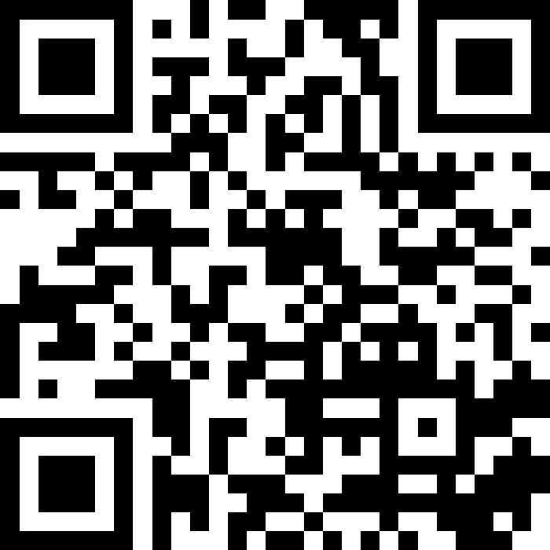
Welcome and Ice Breaker!
slido.com # 4277878

Slide 3
Modules 1-3: Recap
CCDPH Data Ambassadors Program
September 2025
Notes:
Module 1: Understanding Health Equity and Population Health; Modules 2-3: Navigating the Health Atlas and Data Analysis and Application (learned how to interpret data and apply it to your work) Remember all the materials will be posted to the website if you missed a session or want a refresher. The full toolkit will also be available on the website once it is complete.

Slide 4
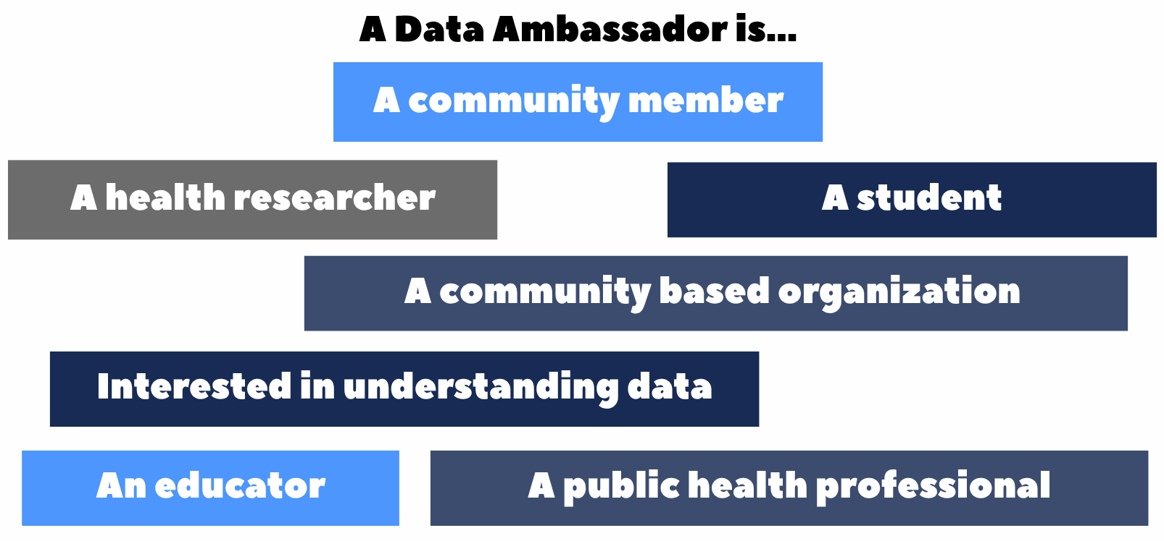
Module 4: Becoming a Data Ambassador

Slide 5
Learning Objectives
Module 4: Becoming a Data Ambassador​
Health Atlas Workspaces
Data Storytelling
Staying Connected

Slide 6
Developing Atlas Workspaces
Take the skills you’ve learned on the Atlas and develop your own workspaces!
Workspace is a Cook County Health Atlas feature that allows you to be able to:
Save visualizations (maps, charts, or tables)
Access and review previously saved visualizations through various forms
Visualizations are only limited to any indicator and place available on the Atlas
At the end of today’s session when you complete the evaluation you will be asked about your interest in signing up for a Cook County Atlas workspace account.
*Available only to those with login credentials

Slide 7
What is Data Storytelling?
With health equity at the center of work, CCDPH, UIC PHAME Center, and community based organizations tirelessly work to integrate data to help individuals, communities, and other stigmatized social classes feel seen and heard.
Data storytelling allows us to communicate insights using data through the use of narratives and visualizations to inspire our community members, policymakers, and stakeholders to take action.
For example
Having visual evidence such as photovoice or personal testimonies can be used to persuade our audience to take action or solicit funds from grantors

Slide 8
Data Storytelling-Create A G.A.M.E. Plan
Goal
Audience
Message
Engagement
Determine what you hope to achieve with your story.
Be concrete
Understand who your audience is.
Who are the decision makers and who can influence the process?
Determine the most important message you’d like to communicate.
Narrow them down to a few key points to internalize and remember.
Channels: email, regular mail, websites, social media, webinars, in-person.
Medium: Websites, printed reports, videos, presentations.

Slide 9
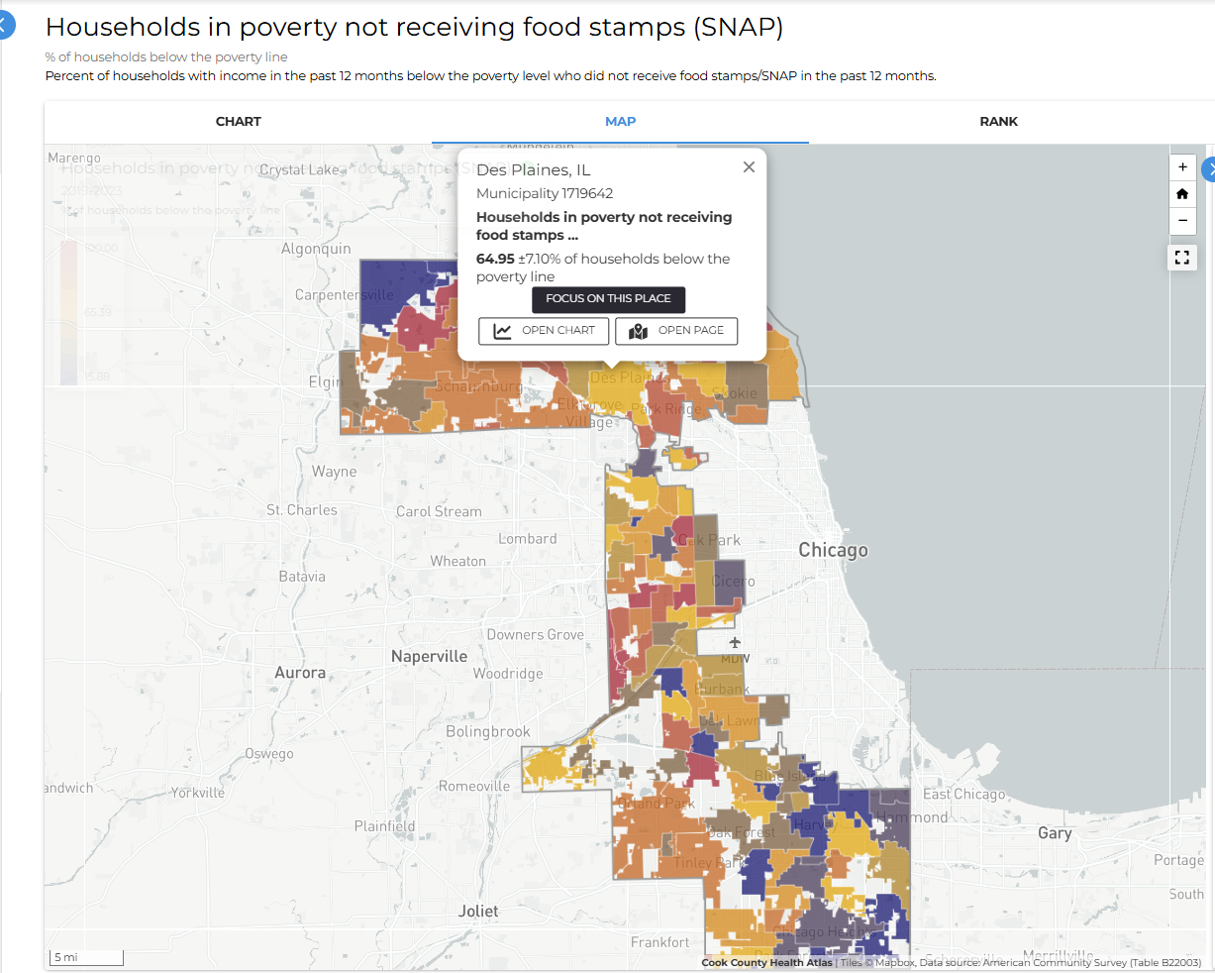
Activity: Data Storytelling
Mike's SNAP outreach data story
Mike, a SNAP Outreach Coordinator, wants to know where to focus his efforts in suburban Cook County. Using the Health Atlas, he looked at data on households receiving SNAP and those in poverty not receiving benefits, paying special attention to Des Plaines.
As you completed this activity, you explored how data can highlight unmet needs, identify disparities across neighborhoods, and help prioritize outreach strategies for communities like Des Plaines.
Notes:
Using information from Module 3: Mike’s Food Insecurity Case Study we will tell a story using data.

Slide 10
Activity: Data Storytelling
G: (Goal): Create an understanding that 64% of eligible households in Des Plaines in poverty are not enrolled in the Supplemental Nutrition Assistance Program, creating an enrollment gap which means a large number of households are missing a critical piece to food security. These low enrollment rates combined with the fact that Non-Hispanic Black residents of Suburban Cook County face the highest rates of need, indicate an inequity challenge that needs to be addressed through targeted outreach.
A: (Audience): Who is this information directed to?
Who are the decision makers?
Existing partners/networks?
Who would benefit from this targeted outreach?
M: (Message): What is the most important thing I am trying to convey?
The need exists.
How to address the need?
How will this intervention lead to better enrollment outcomes?
E: (Engagement): How do I get the message to my targets?
What is the best medium to convey your findings, their implications and possible interventions?
Is there a call to action?
Notes:
How to address the need? Targeted outreach-pop up snap enrollment events at key locations, in multiple languages

Slide 11
Activity: Data Storytelling Discussion
What other information could be useful for Mike to plan his outreach and communication efforts?
Qualitative Data-Understanding the reasons behind low SNAP enrollment
Surveys
Focus Groups
Socioeconomic context
Data on unemployment rates
Language proficiency in target areas would help communication and support services
Community Resource Maps
Location of existing food pantries, farmers markets that accept SNAP
Other social service organizations to coordinate outreach and referrals
Notes:
How to address the need? Targeted outreach-pop up snap enrollment events at key locations, in multiple languages

Slide 12
Activity: Data Storytelling Discussion
What questions does this activity raise that may or may not be answered by the data?
Data Limitations
Program Effectiveness
Sustainability
Equitable Access
Systemic Barriers
Notes:
How to address the need? Targeted outreach-pop up snap enrollment events at key locations, in multiple languages

Slide 13


Activity: Data Storytelling Tips
Visuals can be a powerful addition to a data story.
Images should draw your reader into your story but also indicating what your story is about
They should support your narrative
A great video can be far more engaging and informative than a picture.
Use color! Colors do more than make your story look pretty. They suggest emotion. Color.adobe.com
To write or not to write.
Writing is the centerpiece of your data story. All other elements are there to support and amplify your message.
Titles should pop.
2025 Public Transit Budget
15% More Funding for Public TRansit in Outer Neighborhoods
Notes:
How to address the need? Targeted outreach-pop up snap enrollment events at key locations, in multiple languages

Slide 14
Activity: Data Storytelling Tips
Make your story easy to read!
Be careful not to make your story unnecessarily difficult to read or understand. (Jargon, abbreviations and acronyms your audience may not be familiar with.
Pull out quotes or other key points and give them more prominent visual treatment with text boxes, quotations, icons
“Clarity of writing usually follows clarity of thought. So think what you want to say, then say it as simply as possible.”
-The Economist, Style Guide
Special attribution to LiveStories a user friendly platform that helps you present data in engaging and effective ways.
Notes:
How to address the need? Targeted outreach-pop up snap enrollment events at key locations, in multiple languages

Slide 15
Staying Connected
Information on how to stay connected with Cook County,
Resources on CCPDH DAP Website & Toolkit
Data Request Forms-Cook County Department of Public Health
Cook County Department of Public Health Newsletter Sign Up
Link to Form for Atlas support
https://cookcountyhealthatlas.org/contact

Slide 16
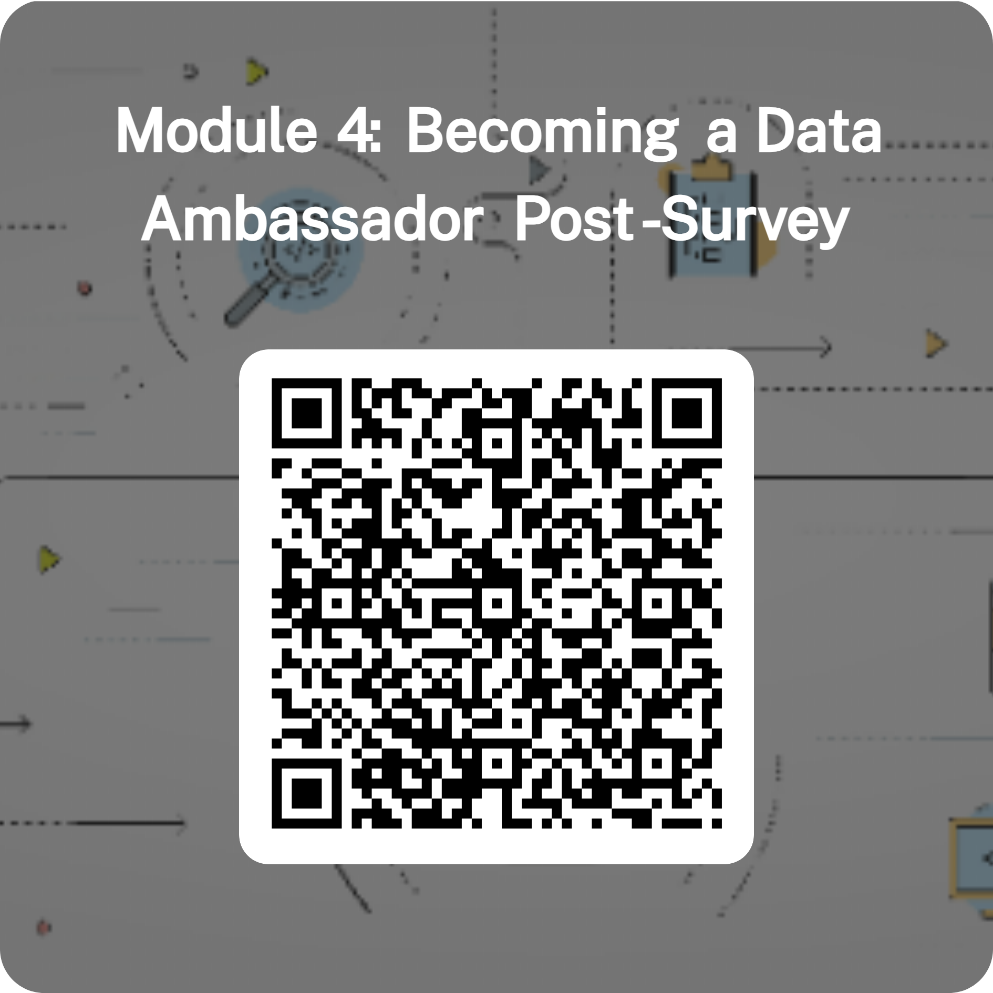
Thanks and Post-Survey
Notes:
Thanks so much for your active and engaged participation this week in the Data Ambassador Program Workshop Series co-designed with you, for you!

Slide 17
Activity: Developing Atlas Workspaces
Taking the skills you’ve learned on the Atlas and developing your own workspaces

Slide 18
Data Storytelling
https://docs.google.com/document/d/1aQst9WZAz4AlUGhRpMYsKo00rDGW1Liq9ms6i4tqqLo/edit?usp=drive_link (case study link)
Notes:
How to address the need? Targeted outreach

